Slide 1
CHARITY NGO PROJECT
ServeUnity
“United by Service, Driveny Impact”

Slide 2
Introduction:
Charity NGO is a non-profit organization dedicated to uplifting underprivileged communities.
Our mission is to provide equal opportunities in education, ensure access to clean water, and improve healthcare facilities for all.
We believe in the power of collective action and compassionate support.

Slide 3
Technologies Used:
Technology
Purpose
HTML
CSS
JavaScript
PHP
MySQL
Structure of web pages
Styling and Layout
Interactive features (form validation, animations)
Server-side logic (form handling, database connection)
Storing donation data and user records

Slide 4
Website Features
Responsive design for mobile & desktop
Separate pages for Home, About, Programs and Donations
Reusable Navbar and Footer
Secure form handling
Donation data stored and retrievable via MySQL

Slide 5
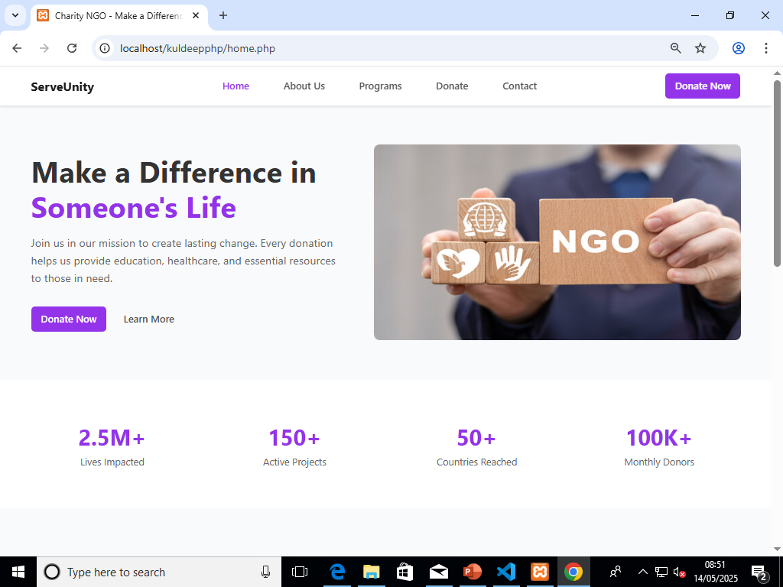
Home Page Overview
**Welcome to ServeUnity – United in Service, Driven by Purpose**
Our homepage reflects the mission and heart of ServeUnity – to bring people together for a greater cause. With a modern, user-friendly interface, we aim to inspire action and make donating and volunteering easy, transparent, and accessible to all.

Slide 6
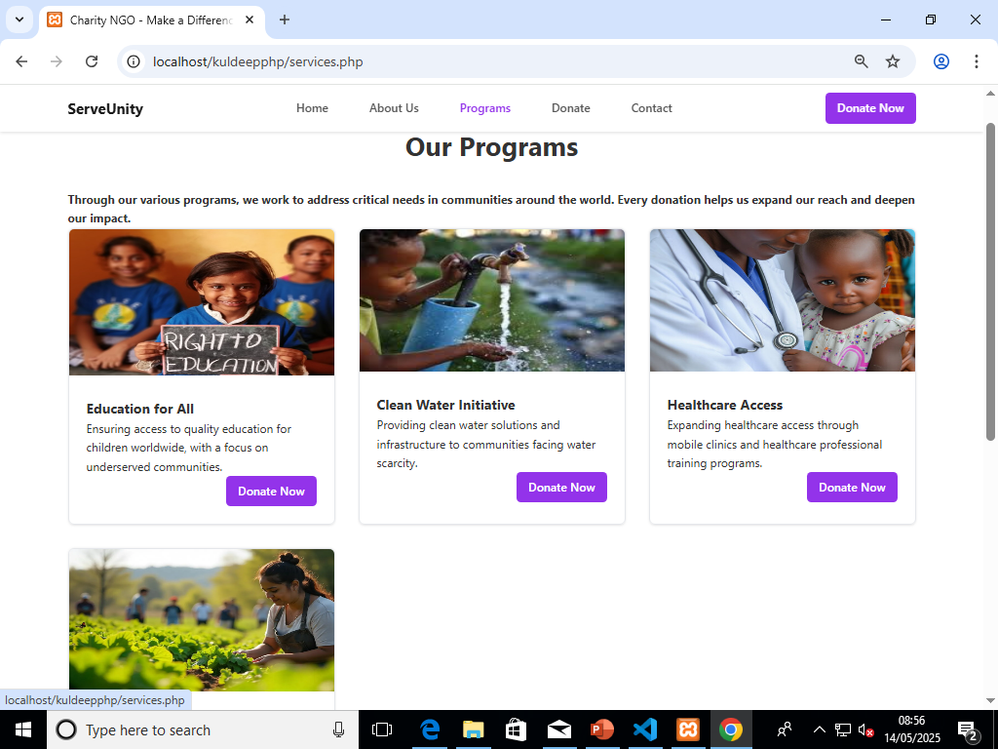
Core Initiatives
1. Education for All
Free schooling for children in rural and slum areas
Adult literacy programs
School supply donation drives
2. Clear Water Initiative
Building hand pumps and bore wells
Water purification awareness
Rainwater harvesting projects
3. Healthcare Access
Mobile medical camps
Free medicine distribution
Health awareness programs (Hygiene, Nutrition)

Slide 7
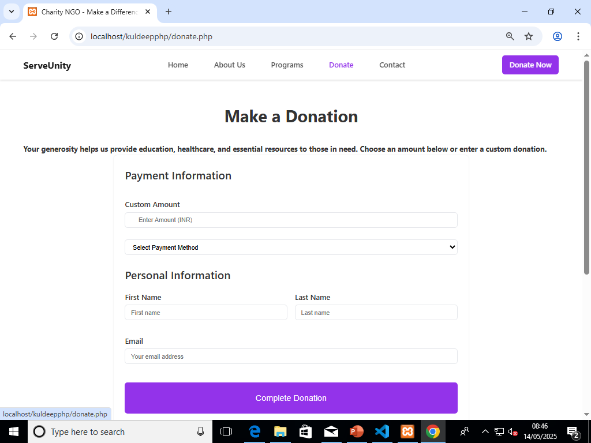
Donation Form
Fields Included:
Name
Email
Donation Amount
Payment Method (UPI /Bank Transfer / Card)

Slide 8
Vision & Mission
Vision:
A world where everyone has access to basic human needs and opportunities to live a dignified life.
Mission:
To promote literacy and education for children and adults.
To implement sustainable clean water solutions.
To provide affordable healthcare to underserved populations.

Slide 9
How you Can Help
Sponsor a child’s education
Donate for water well installations
Support a health camp
Volunteer for field projects
Fundraising events
Share on Social Media

Slide 10
Thank you
Thank You for your Time & Support
“Small acts, when multiplied by millions of people,
can transform the world.”
__Howard Zinn
We look forward to walking the path of service together.

